Slide 1
Data Warehousing and Data Mining

Slide 2
Introduction To Data Warehousing
Database-Collection of related data
- structured with defined schema
-Information organized in rows and columns
-Ex MySQL, ORACLE, SQL
Data Warehouse- Special type of database
- Analysis and report
- Support for Business Intelligence Activities
- Ex:How Much % percentage Discount
- MY SQL with Special Data warehouse

Slide 3
Condt
Data Lake- It is centralized repository that allows you to store all structured and unstructured data at any scale
Ex: AWS, Azure,BigQuery…

Slide 4
Database Vs Datawarehouse
S.No | Database | Datawarehouse
1. | Transactional Based | Analytical Based
2. | Used to Store data ,retrieve,.. | Used to Analysis data Prediction of data Decision support
3. | OLTP | OLAP
4. | Fundamental operation of business | Help to analyse the business
5. | Day to Day Processing | Historical Processing
6. | Relational Database | Multidimensional arrays

Slide 5
Features of DW
Subjected oriented-It provides information catered to a specific subject instead of the whole organization’s ongoing operations
Integrated-it is developed by combining data from multiple sources, such as flat files and relational databases, which offers better data analysis.
Time variant -The data in a DWH gives information from a specific historical point of time. The data is categorized with a particular time frame.
Non –volatile -Non-volatile refers to historical data that is not omitted when newer data is added.
-previous data is not erased when new data is entered in it

Slide 6
Datawarehouse Architecture
To design an effective and efficient data warehouse, we need to understand and analyze the business needs and construct a business analysis framework.
The top-down view allows the selection of the relevant information necessary for the data warehouse.
The data source view exposes the information being captured, stored, and managed by operational systems.
The data warehouse view includes fact tables and dimension tables.
business query view is the perspective of data in the data warehouse from end user. It is the view of the data from the viewpoint of the end-user.

Slide 7
Three-Tier Data Warehouse Architecture
Three layer/Tier
Bottom Tier (Data Warehouse Server)
Middle Tier (OLAP Server)
Top Tier (Front end Tools).

Slide 8
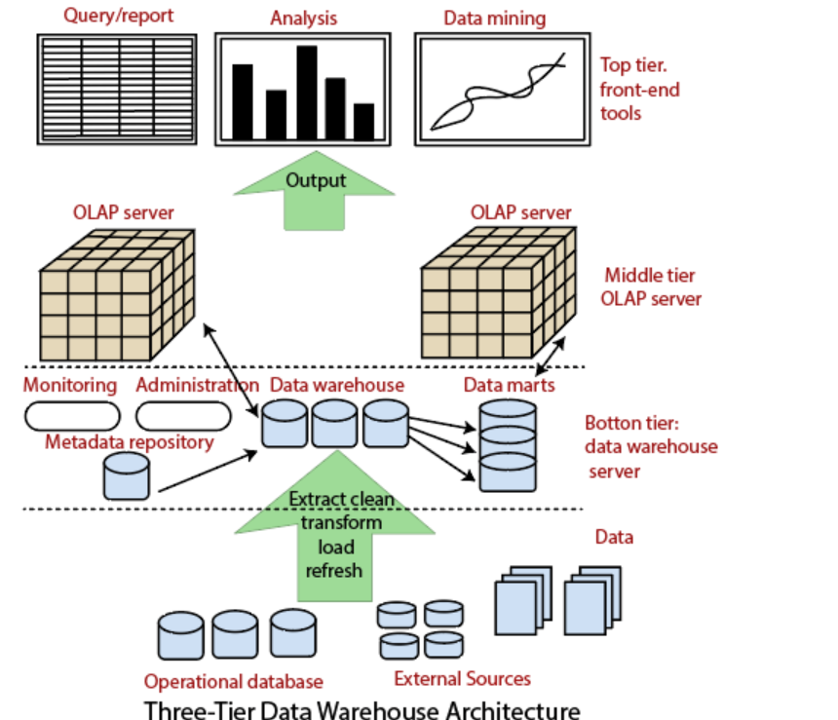
Architecture:

Slide 9
Condt
Database of the DW server
It is usually relational DBMS
Fetch only relevant information based on data mining request .
Data is cleaned , transformed and loaded into this layer using back end tools (ETL)
Function provided by back end tools are:
Data extraction
Data cleaning
Data transformation
Data load
Data refresh

Slide 10
Component in Data Warehouse
Data Warehouse
Meta Data-data about data , defining DW
- Used for building and maintaining and managing DW
-Includes : Data name, definition, source of data, algorithm used for cleaning ….
For Example: 103 NK78 30000
Model No:103 ; NK78-Agent ID no ; Total sales-3000;

Slide 11
Condt
Technical Meta Data- contains information about DW
-used by database designer and administrators
Business Meta Data-contains information about data ,
- used by end user
- without meta data we cant conclude , what its represent

Slide 12
COndt
3.Data Mart:- Subsidiary of data warehouse ,contain small slice of data
Example: single department data
Dependent :sourced directly from DW
Independent: Sourced from one or more database
4.Monitoring and administration:
Includes refreshment and data recovery
Limiting the size of DW controlling the number and ranges of queries, manage the data base performance

Slide 13
Condt
Middle Tier: OLAP server
Concept of multidimensional database
It allows users to analyze the data using multidimensional views
OLAP Server Implemented by two models: ROLAP
MOLAP

Slide 14
Condt
Top Tier: Front ends Tools/ Front End client Layer
Query tool and report tool: production of report
Query tool: creation of SQL
Application dependent tool:
Data mining Tool:

Slide 15
Multidimensional Data Model
OLAP Cube –Data structure used quick data analysis
ETL tools- Data’s loaded into OLAP Cube
4 operations:
1.Roll-up(drill –up)
- Uses the concept of Hierarchy
Profit of company
Profit from cloths
Profit from electronics
Profit from kitchen item

Slide 16
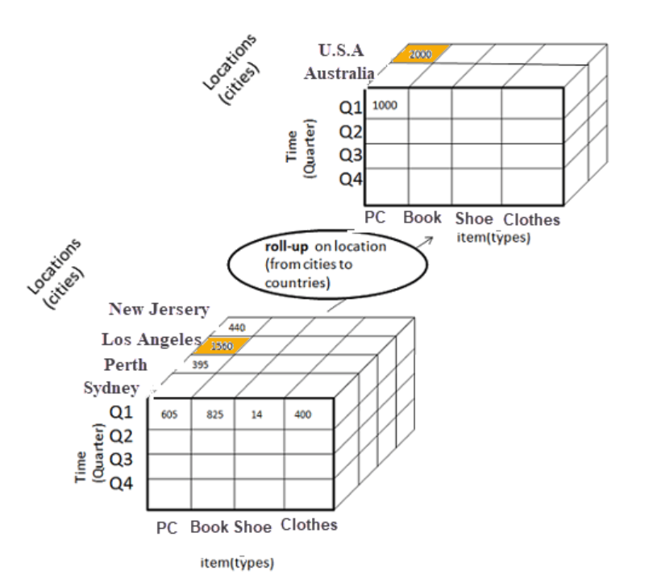
condt

Slide 17
condt
Drill Down-
-Reverse of drill up
- data is drilled down
Profit of company
Profit from cloths
Profit from electronics
Profit from kitchen

Slide 18
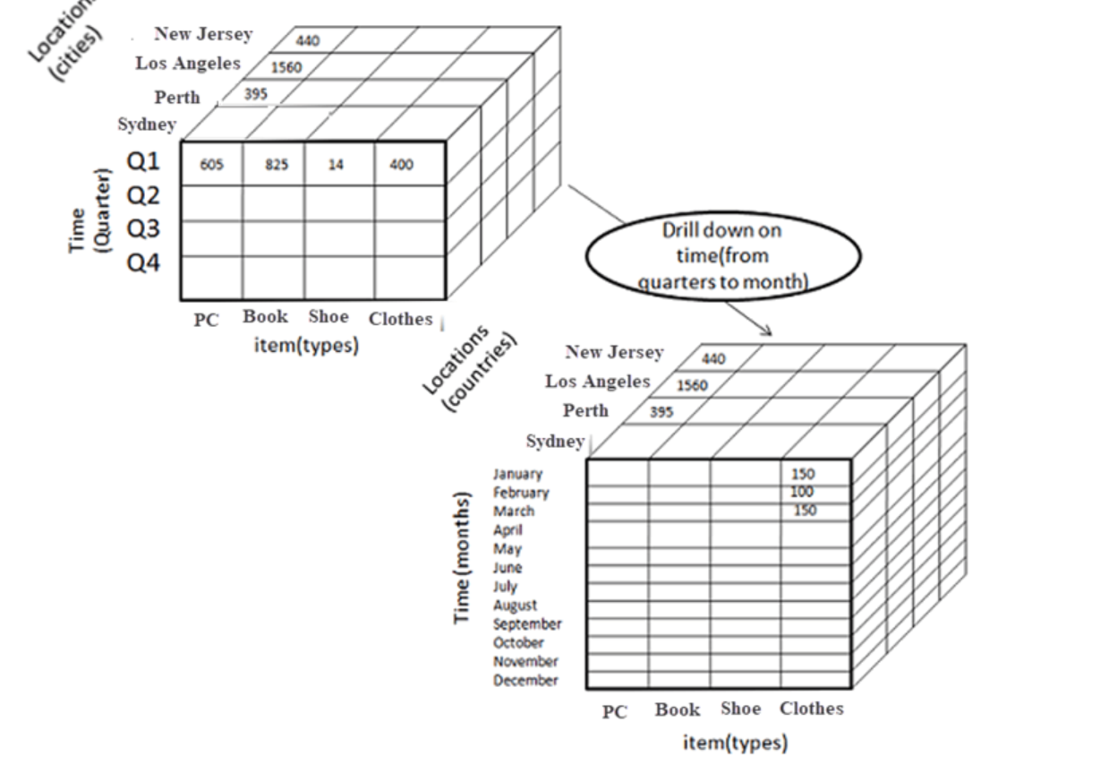
condt

Slide 19
Condt
Slice :
Data cube is sliced and information is divided and new cube’s is formed
Dimension Time is Sliced with Q1 as the filter.
A new cube is created altogether.

Slide 20
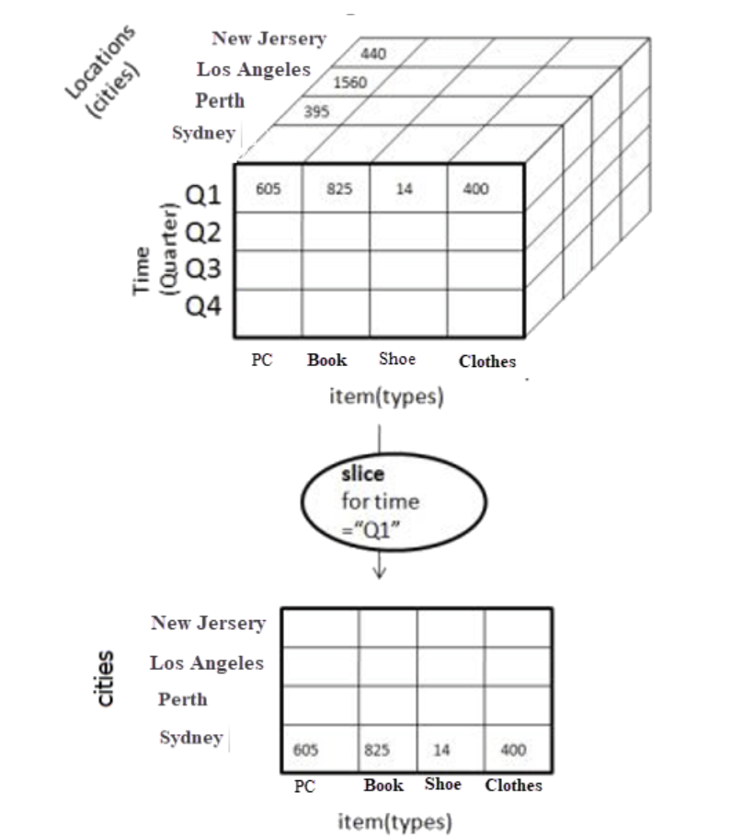
condt

Slide 21
Condt
Dice:
This operation is similar to a slice. The difference in dice is you select 2 or more dimensions that result in the creation of a sub-cube.

Slide 22
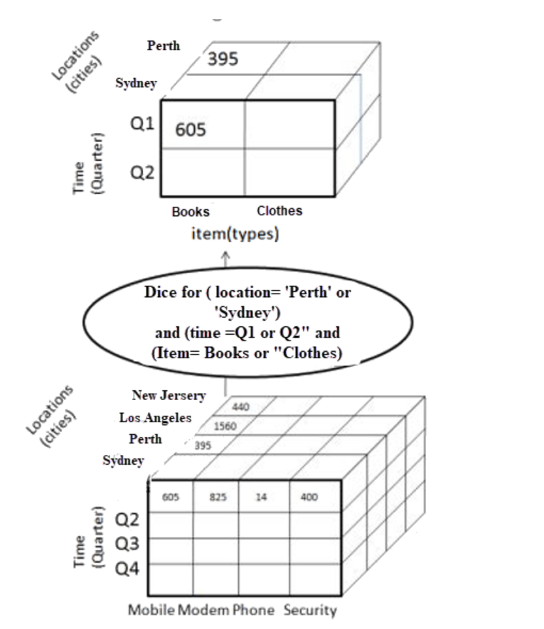
condt

Slide 23
Condt
4) Pivot
In Pivot, you rotate the data axes to provide a substitute presentation of data.
In the following example, the pivot is based on item types.

Slide 24
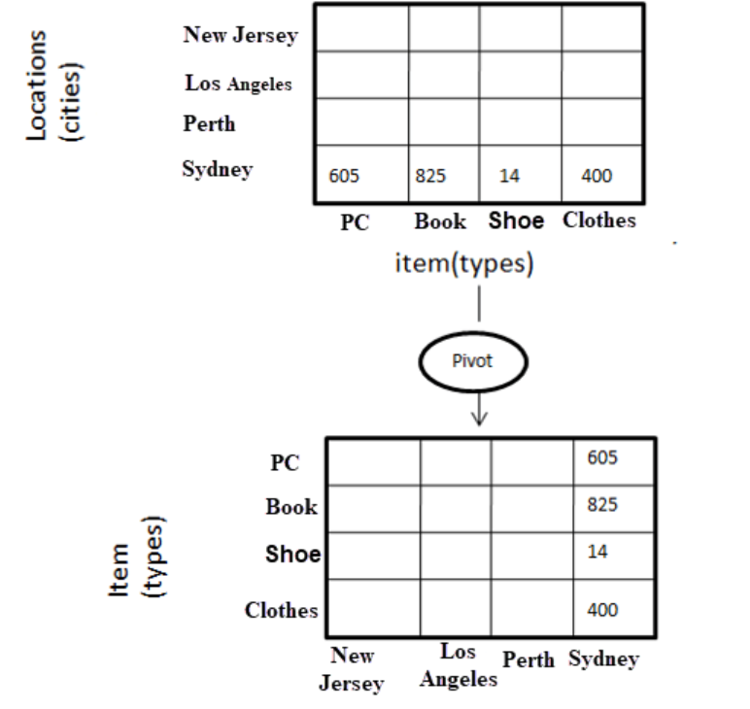
condt

Slide 25
OLAP SERVER TYPES
ROLAP
MOLAP
HOLAP
ROLAP:
- Relational OLAP
Tools can analyze large amount of data
ROLAP tools store and analyze volatile data
Expertise person can deal with ROLAP
Dis adv: Poor query performance

Slide 26
condt
MOLAP:
-Multidimensional OLAP
-MOLAP easy to use
-Information retrieval is fast
-Can perform complex computation
HOLAP:
-Hybrid OLAP
-Complex computation
-large amount data

Slide 27
Data Pre-processing
It is done to improve the quality of data in data warehouse
Data cleaning
-Process of removal of incorrect, incomplete ,inaccurate data (Noisy data)
-replacing missing data

Slide 28
COndt
Ways to handle the missing data during cleaning:
- Manual Entry of missing data
Using attribute “ MEAN”
Using Attribute”Medium”
Using “Most probable value “
Using global constant [NA]
Ignore that tuple

Slide 29
Condt
Noisy Data:
Binning:
Data:10,2,19,18,20,18,25,28,22
Sort:2,10,18,18,19,20,22,25,28
2,10,18
18,19,20
22,25,28
Bin Size =3

Slide 30
condt
Smoothing by BIN Mean
Value of bin is replaced by mean Value(Average )
2, 10,18-----2+10+18=30/3=10
18,19,20------18+19+20=57/3=19
22,25,28-------22+25+28=75/3=25
10,10,10
19,19,19
25,25,25

Slide 31
Condt
Smoothing by Medians
Odd=n+1/2
Even=n/2
10,10,10
19,19,19
25,25,25

Slide 32
Condt
Smoothing by Bin Boundaries:
Two Min and Max value
2,10,18
18,19,20
22,25,28
2, 2, 18
18 18 20
22 22 28

Slide 33
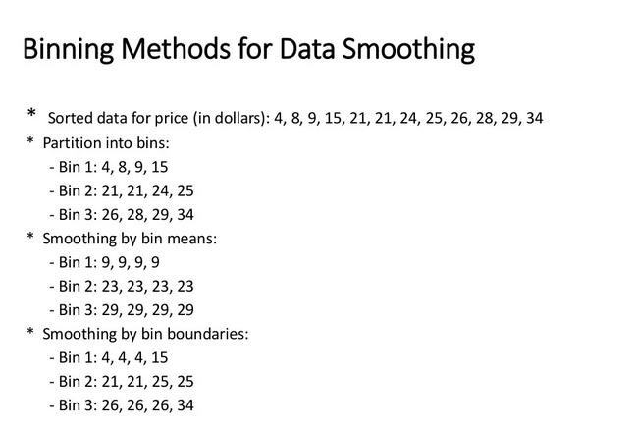
condt

Slide 34
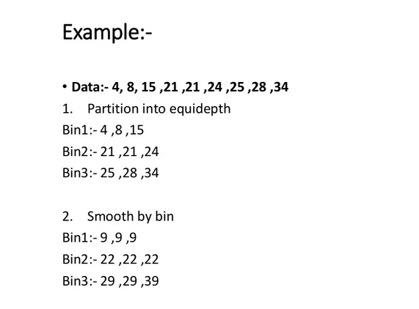
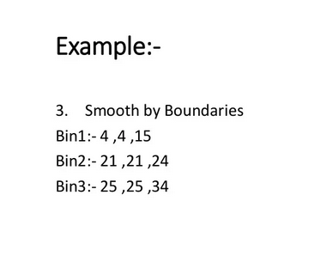
condt

Slide 35
condt
(II) Regression
-fitting data into function
-Linear Regression- fit two attributes
-Multiple linear regression –more than two attributes fitted into multidimensional surface
(iii)Clustering
-Similar values are organized into groups
-values that fall outside the clusters may be considered outlier

Slide 36
Data Integration
It is preprocessing method that involves merging of data from different sources in order to form a data store like data warehouse.
Issues in Data Integration:
Schema integration and object matching
Redundancy – unwanted attributes (Derived from other attributes)
Detection and resolution of data value conflicts

Slide 37
Data transformation
It is data pre-processing technique that transform the data into alternative forms appropriate for mining .
Techniques:
Smoothing-Removing noise from data[binning by mean, medium, boundary, regression, clustering ]
Aggregate –summary or aggregate function [constructing a data cube]
Generalization-lower level concept are replaced with higher level
Normalization- attribute’s values are normalized by scaling their values . So that they fall in specified range

Slide 38
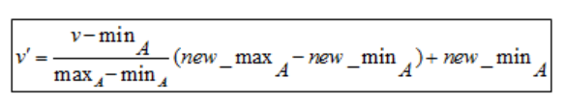
Condt.
Min – Max Normalization:
Z-score normalization:

Slide 39
condt
marks
8
10
15
20
Min:
The minimum value of the given attribute. Here Min is 8
Max:
The maximum value of the given attribute. Here Max is 20
V: V is the respective value of the attribute. For example here V1=8, V2=10, V3=15, and V4=20
newMax:
1
newMin:
0

Slide 40
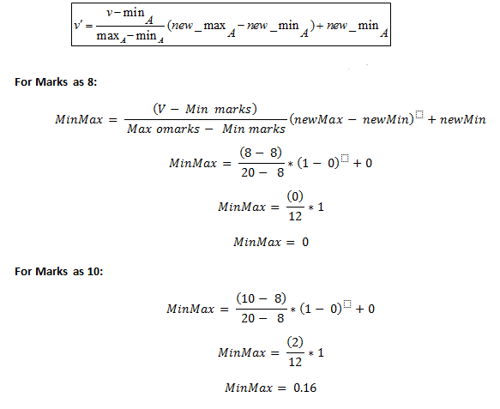
condt

Slide 41
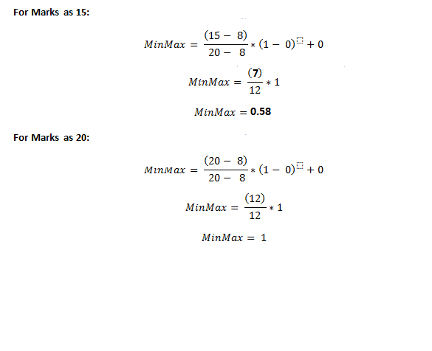
condt

Slide 42
condt
marks | marks after Min-Max normalization
8 | 0
10 | 0.16
15 | 0.58
20 | 1

Slide 43
Problem 2
Suppose we have to normalize the following data set, 200, 300, 400, 600, 1000 to a new range [0, 1], then using min-max normalization
min = 200, max = 1000, new_min = 0, new_max = 1

Slide 44
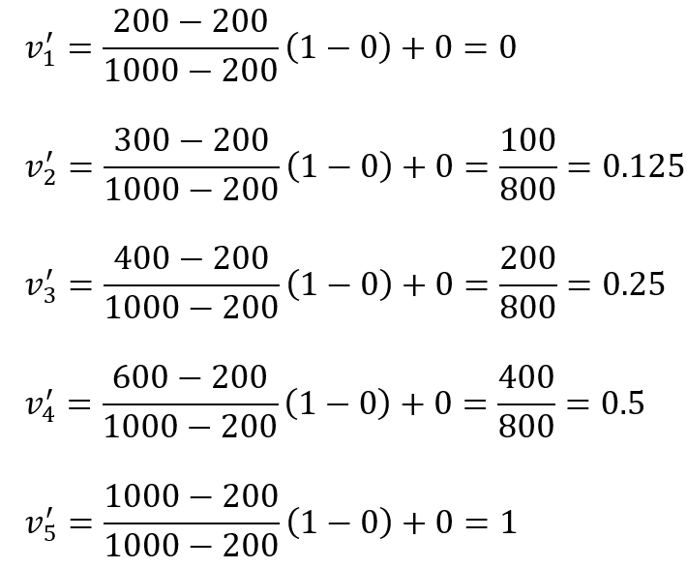
condt

Slide 45
condt
Zero- Score Normalization
New value = (x – μ) / σ
x: Original value
μ: Mean of data
σ: Standard deviation of data

Slide 46
condt
How to calculate Z-Score of the following data?
marks
8
10
15
20

Slide 47
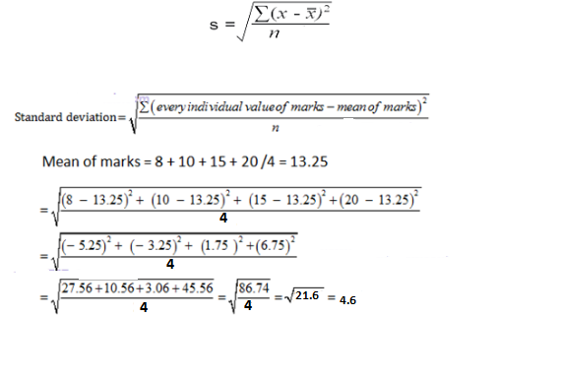
condt

Slide 48
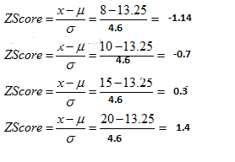
condt
Mean = 13.25
Standard deviation = 4.6

Slide 49
condt
marks | marks after z-score normalization
8 | -1.14
10 | -0.7
15 | 0.3
20 | 1.4

Slide 50
condt
marks | marks after z-score normalization
8 | -1.14
10 | -0.7
15 | 0.3
20 | 1.4

Slide 51
Problem 2
we have to normalize the following data set, 200, 300, 400, 600, 1000 then using Z-Score normalization

Slide 52
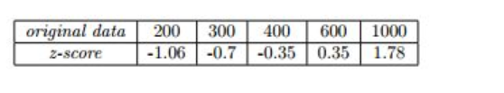
condt

Slide 53
Decimal Scaling
A value v of attribute A is can be normalized by the following formula
Normalized value of attribute = ( v^{i} / 10^{j} )
Example of Decimal scaling :
CGPA | Formula | CGPA Normalized after Decimal scaling
2 | 2/10 | 0.2
3 | 3/10 | 0.3

Slide 54
Data Reduction
Reduced representation of dataset from the available dataset.
Why data reduction? — A database/data warehouse may store terabytes of data. Complex data analysis may take a very long time to run on the complete data set
Easy visualization
Improve computation time and space
Remove irrelevant /noisy data
-Integrity of the original data should be maintain even after reduction in data volume
-It should produce same analytics result as on original data.

Slide 55
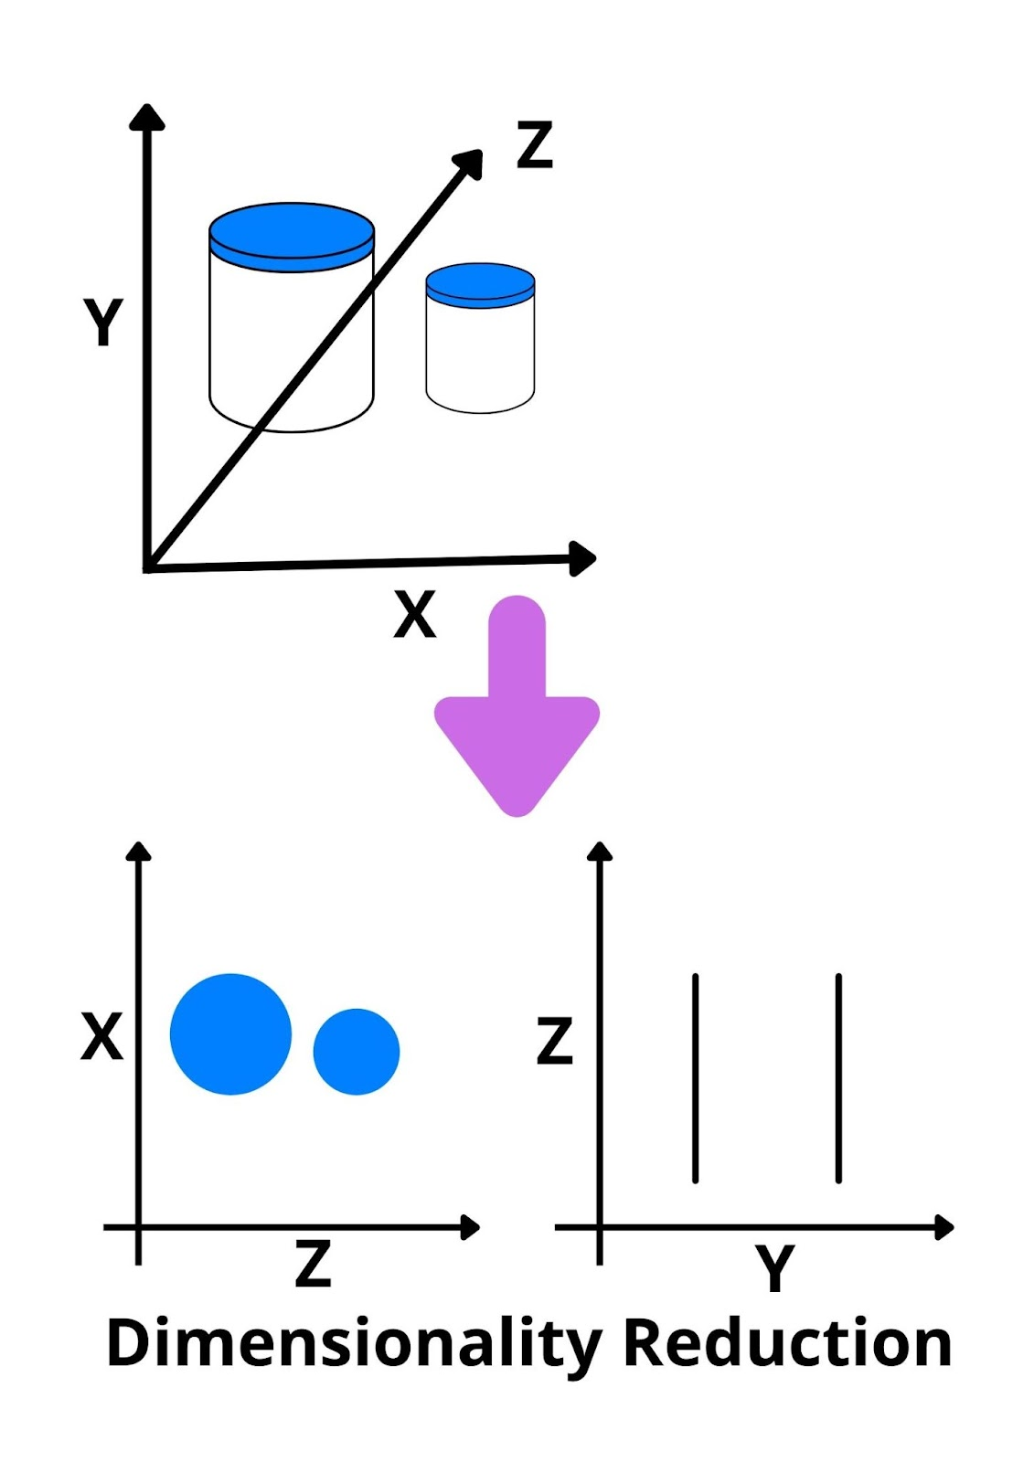
condt

Slide 56
Condt
Dimensionality reduction: Remove redundant attributes
-weakly important data is removed.
-remove outdated or redundancy data.
Two type:
Attribute selection/ feature selection(Subset selection)
{x1,x2} choose one out of two
{x1,x2,x3} choose two out of three
{x1,x2},{x2,x3},{x3,x1}…

Slide 57
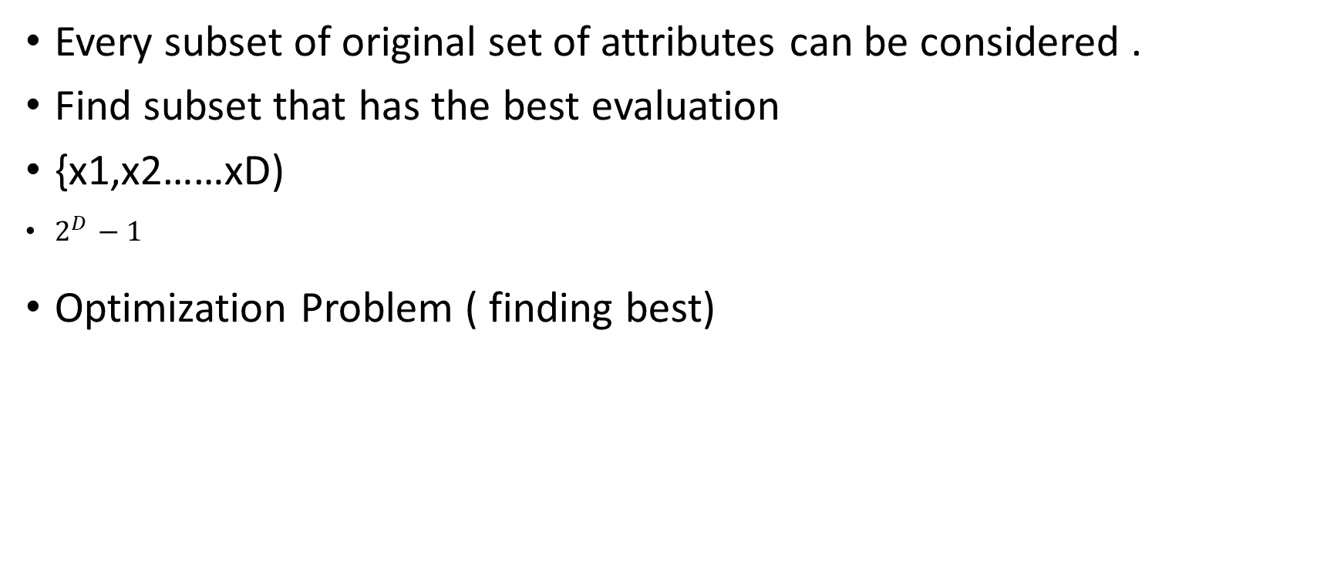
Condt
Every subset of original set of attributes can be considered .
Find subset that has the best evaluation
{x1,x2……xD)
$2^{D }−1$
Optimization Problem ( finding best)

Slide 58
Numerosity Reduction – Data is replaced by estimated value / alter value
Data replaced with mathematical models or smaller form of representation of the data instead of actual data.
Parametric
Non-Parametric

Slide 59
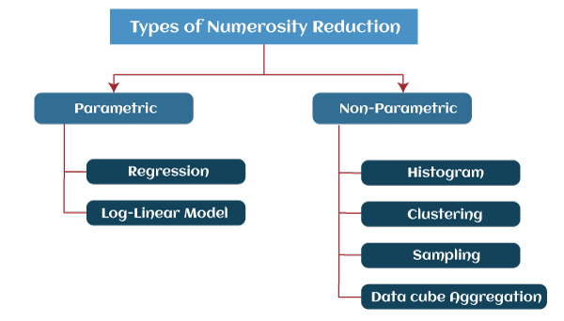
condt

Slide 60
Condt
Parametric: model into which the data fits
y = wx+b
Non Parametric: Not using model
Histogram, Clustering, Sampling, Data Cube Aggregation, Data Compression.

Slide 61
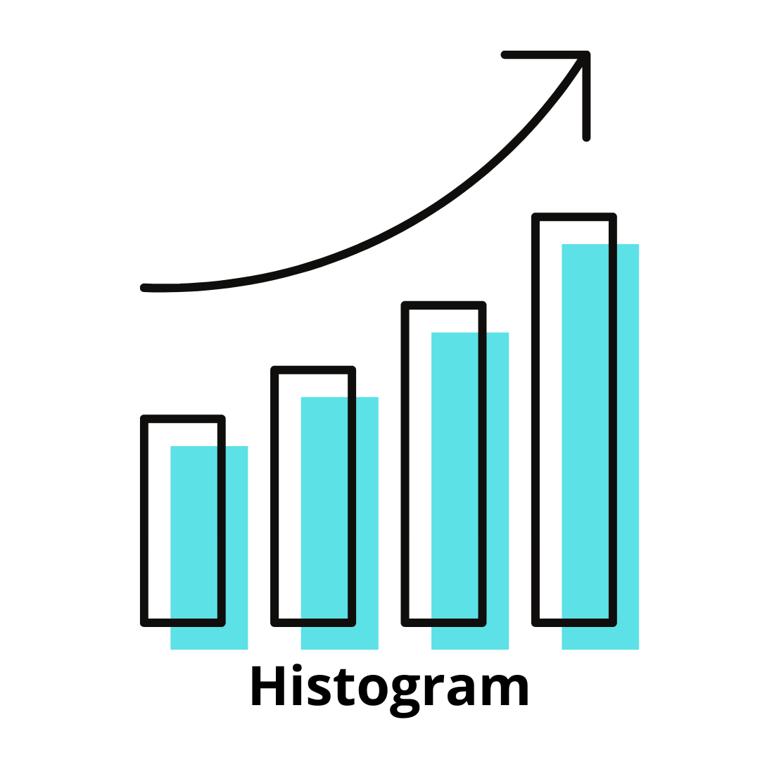
condt
Histograms
divisions the data distribution n of A into disjoint subsets, or buckets
A histogram is a graph that represents frequency distribution which describes how often a value appears in the data

Slide 62
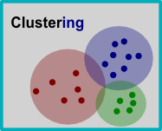
condt
Clustering:
Clustering techniques groups similar objects from the data so that the objects in a cluster are similar to each other, but they are dissimilar to objects in another cluster.
The quality of the cluster depends on the diameter of the cluster, i.e., the max distance between any two objects in the cluster.
Sampling: One of the methods used for data reduction is sampling, as it can reduce the large data set into a much smaller data sample

Slide 63
condt
Data Cube Aggregation:
It is a process in which info is gathered and expressed in summary form
Dataset represented in smaller volume

Slide 64
condt
Data Compression –Encoding of data
-Lossless data reduction –compressed data can reconstructed to form original data without losing any information
-Loss data reduction- Unable to reconstruct the original data from compressed one

Slide 65

PCA(Principal Component Analysis)
Step 1:data set 1:
Step 2: mean of variable
$$X_{i}=1/N(X_{i1 }+X_{i2 }+……………X_{iN }$$
Step 3: Calculate covariance matrix
Covariance of all Pair ($X_{i} ,$ $X_{j})$
COV($X_{i}, X_{j})=\frac{1}{N−1}\sum_{k=1}^{N}{(}X_{ik}−\overline{X_{i }})(X_{jk}−\overline{X_{j }})$
Example 1 | Example 2 | Example 3 | Example 4 | exampleN
X1 | X11 | X21 | X31 | X1N
X2 | X12 | X22 | X32 | XnN

Slide 66
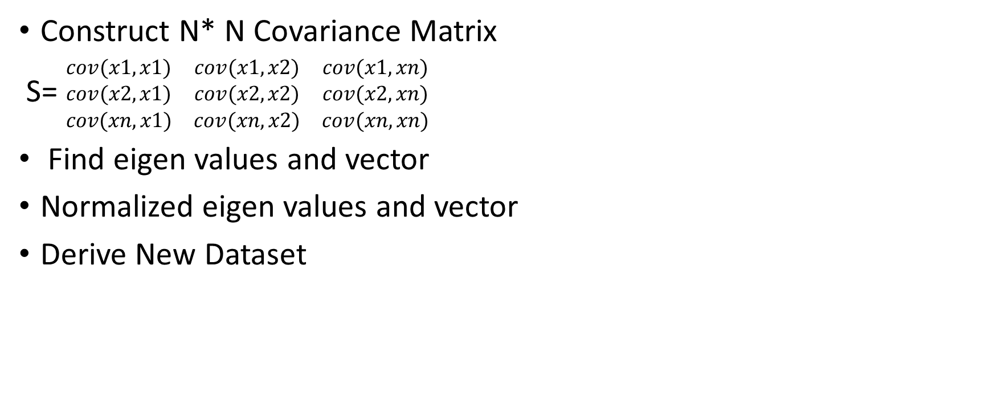
condt
Construct N* N Covariance Matrix
S= $\begin{matrix}cov(x1,x1) & cov(x1,x2) & cov(x1,xn) \\ cov(x2,x1) & cov(x2,x2) & cov(x2,xn) \\ cov(xn,x1) & cov(xn,x2) & cov(xn,xn)\end{matrix}$
Find eigen values and vector
Normalized eigen values and vector
Derive New Dataset

Slide 67
Example
Given Following Data use PCA to reduce the dimension from 2 to 1
Step1:
No of Features: n=2
No. of sample: N=4
Features | Ex1 | Ex2 | Ex3 | Ex4
X | 4 | 8 | 13 | 7
Y | 11 | 4 | 5 | 14

Slide 68

condt
Step 2:
Mean($\overline{X_{j }}=4+8+13+7$)/4=8
Mean($\overline{Y_{j }}=11+4+5+14$)/4=8.5
Step 3:
Computation of covariance Matrix
(x,y)=(x,x)(x,y)(y,x)(y,y)
Cov(x,x)= 1/N-1 $\sum_{k=1}^{N}{(xi−}\overline{X_{ })2}$

